Slide 1
Capstone Project Battle of Neighborhoods
By
Prahlad
25 May 2020

Slide 2
Business Problem Definition
To recommend best neighborhoods in Delhi to open a new Indian Multi Cuisine Restaurant
The final recommendation will be based on the answers to the following queries achieved by analysing the available data :
Analysis of trending venues across neighbourhoods of Delhi
Neighborhoods having large number of Indian restaurants- more supply than demand
Neighbourhoods deficient in supply of Indian restaurants - the demand supply gap
Neighbourhoods overcrowded with multi-category restaurants including Indian restaurants - excess supply over demand.
Finally Zero on to the best neighborhoods in Delhi for opening a new Indian Restaurant.

Slide 3
Data Acquisition
Delhi Wikipedia page to extract the Boroughs & Neighborhood
https://en.wikipedia.org/wiki/List_of_districts_of_Delhi
Data from Kaggle – Neighborhoods of Delhi
https://www.kaggle.com/shaswatd673/delhi-neighborhood-data
Restaurants of Delhi
https://www.kaggle.com/shrutimehta/zomato-restaurants-data
Data from Foursquare
https://developer.foursquare.com/
To get trending venues in each neighborhood
Python Libraries and tools as per the requirement were imported

Slide 4
Data Cleaning
Web Scraping Wikipedia Page
Used BeautifulSoup, lxml and JSON
Generated Pandas Data Frame – Borough and Neighborhood
output table 185X2 (185 rows and 2 columns)
Fetched Latitude and Longitude using Nominatim
Concated the data to create data frame with Borough, Neighborhood, Latitude and Longitude
Droped all NaN values
Final Table 164x4 with attributes
Borough, Neighborhood,Latitude and Longitude

Slide 5
Dataframe after Data Cleaning
Borough & Neighborhood
With Lat & Long
 | Borough | Neighborhood
1. | North West Delhi | Ashok Vihar
2. | North West Delhi | Azadpur
3. | North West Delhi | Bawana
4. | North West Delhi | Begum Pur
5. | North West Delhi | Dhaka
6. | North West Delhi | Jahangirpuri
7. | North West Delhi | Karala
 | Borough | Neighborhood | latitude | longitude
0 | North West Delhi | Adarsh Nagar | 28.714401 | 77.167288
1 | North West Delhi | Ashok Vihar | 28.699453 | 77.184826
2 | North West Delhi | Azadpur | 28.707657 | 77.175547
3 | North West Delhi | Bawana | 28.799660 | 77.032885
4 | North West Delhi | Dhaka | 28.708698 | 77.205749

Slide 6
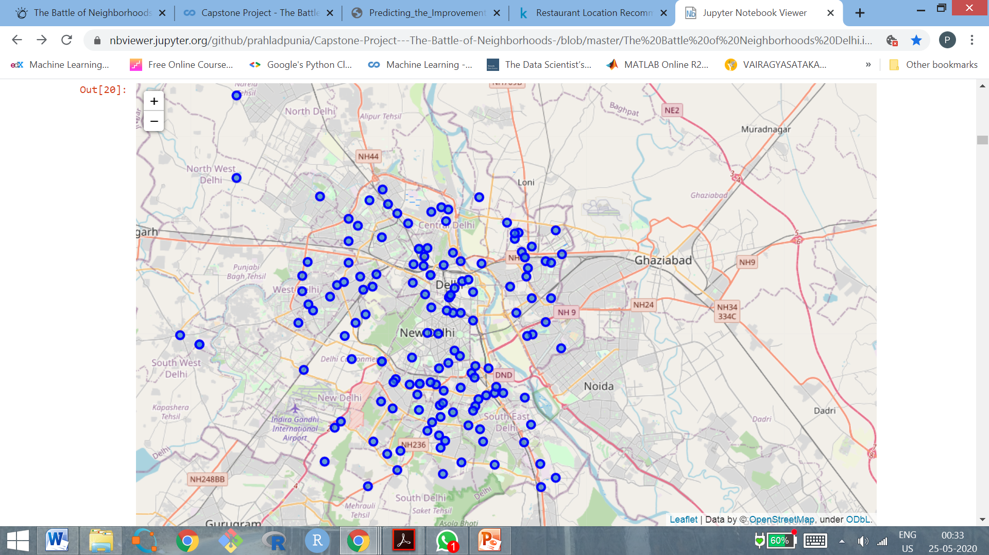
Delhi Map With Neighborhoods

Slide 7
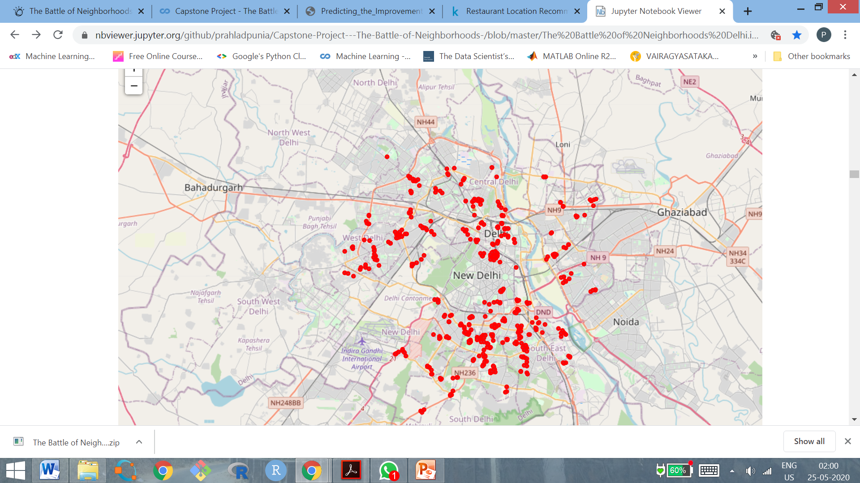
Delhi Map With Restaurants

Slide 8
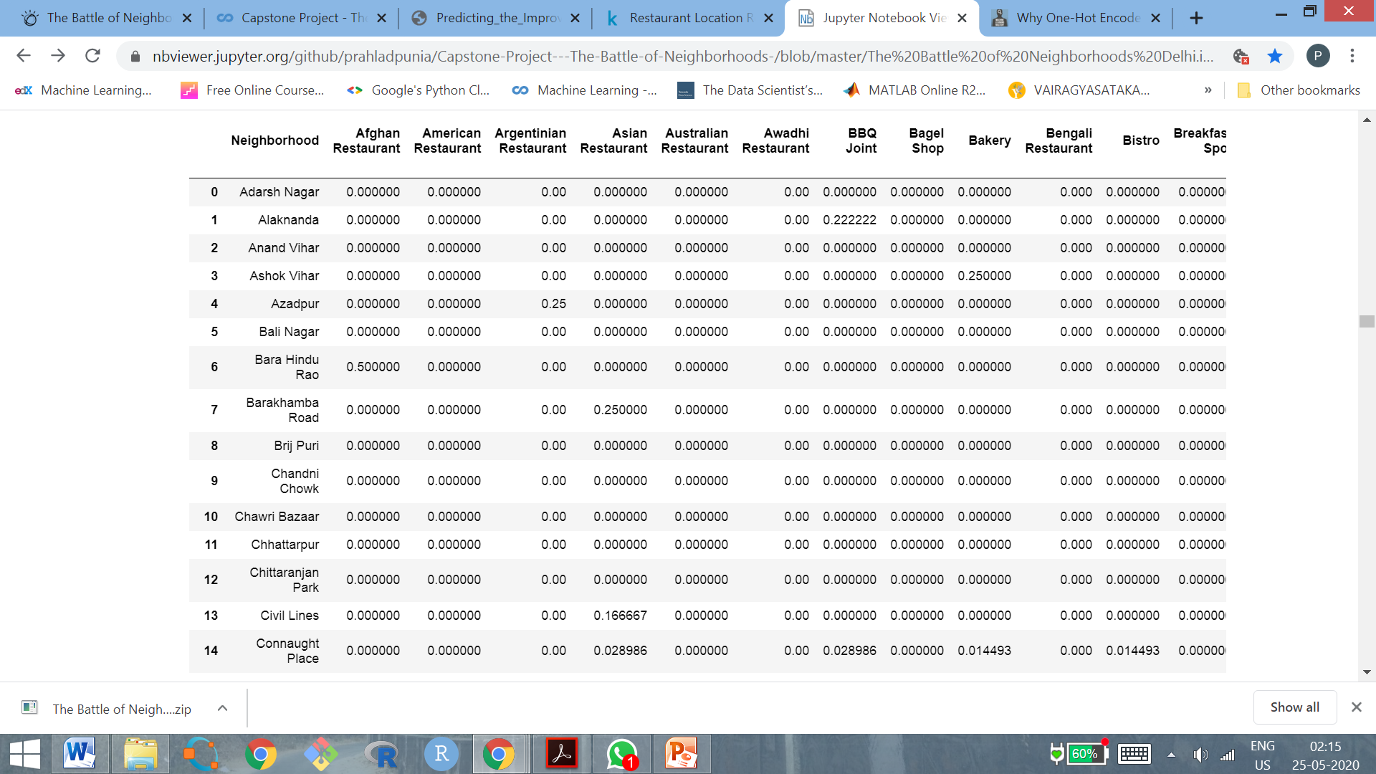
Grouping the Data by Mean of the Frequency

Slide 9
K Means Clustering Algorithm
K-means algorithm was used to get the results
Segregated the Data into Clusters by K-means
After hit & Trial for k=3,4,5,6,7 the value was taken was k=6
Six Clusters of Restaurant data was generated
The array generated by k-means is:
array ([3, 4, 4, 0, 4, 4, 2, 4, 4, 3], dtype=int32) (for k=6)

Slide 10
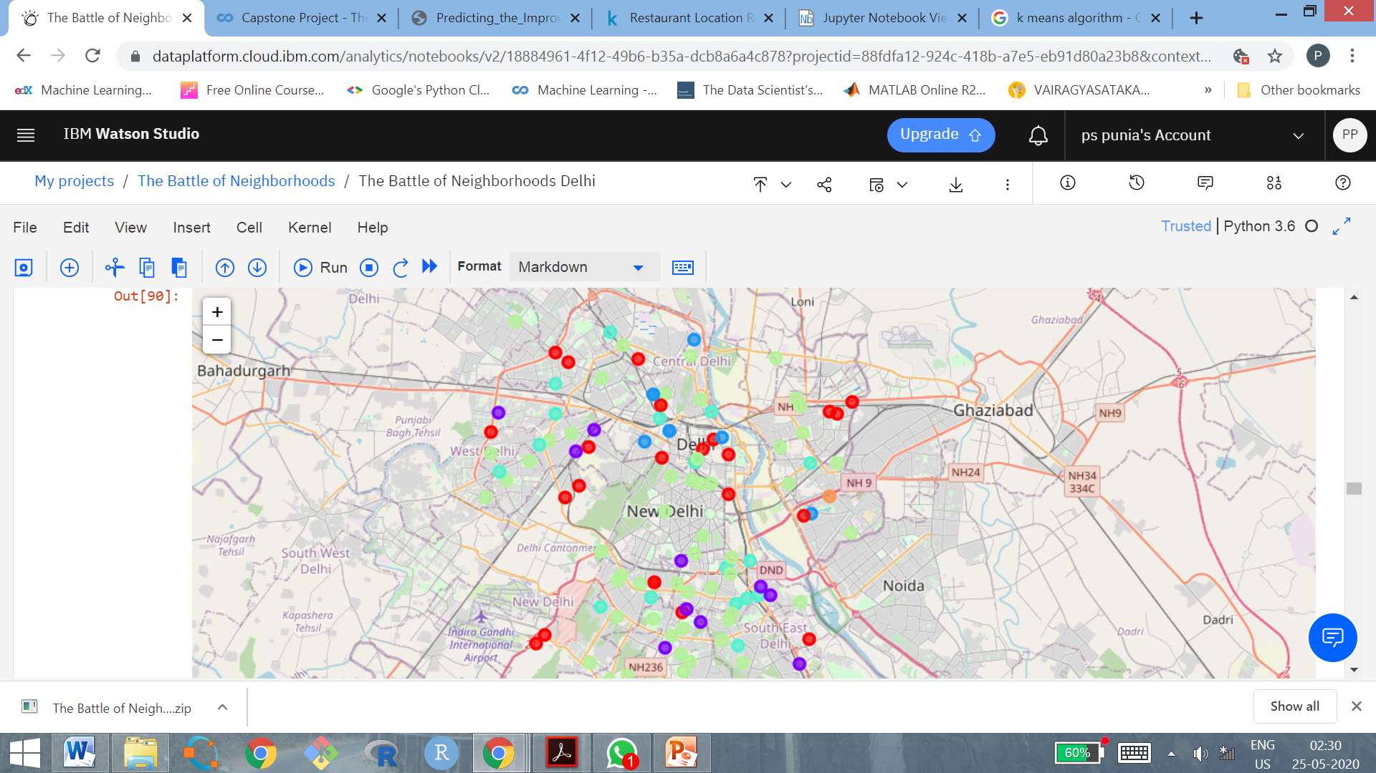
Map of Clusters

Slide 11
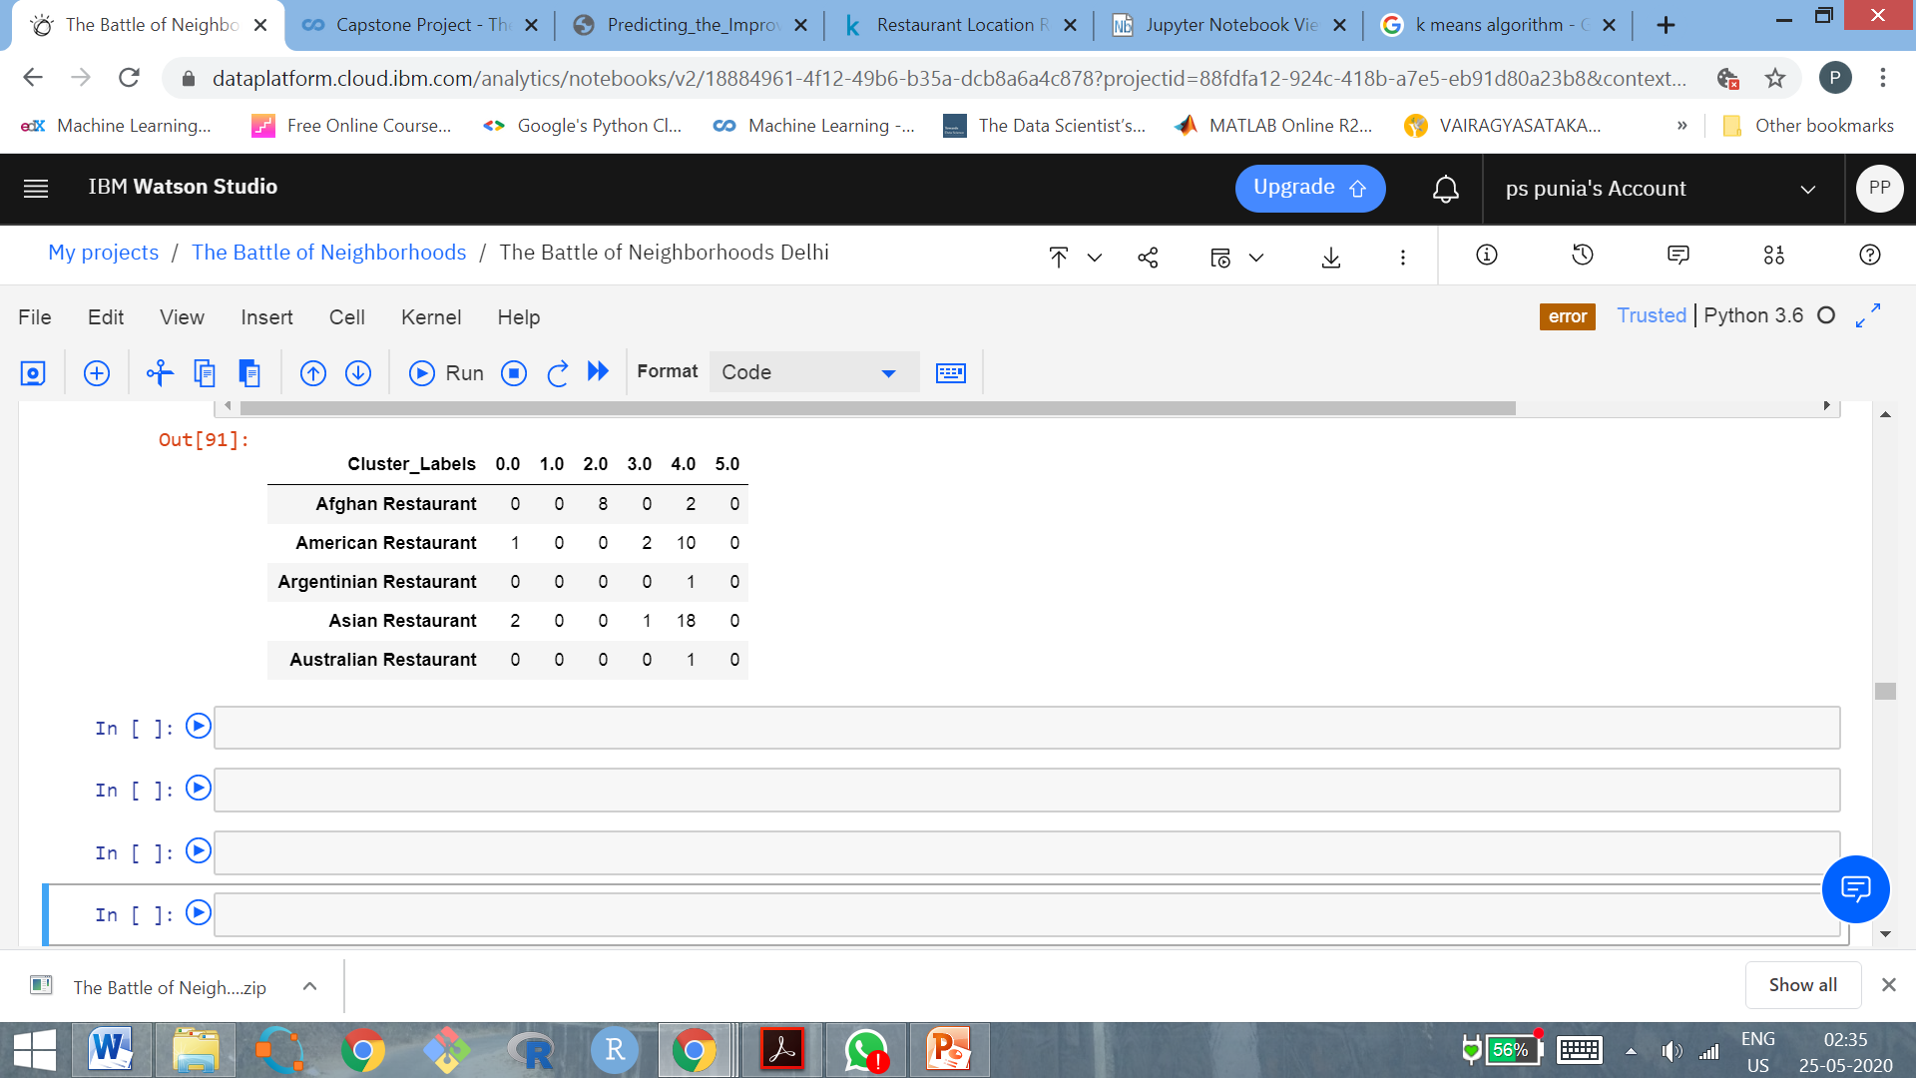
Cluster Dataframe

Slide 12
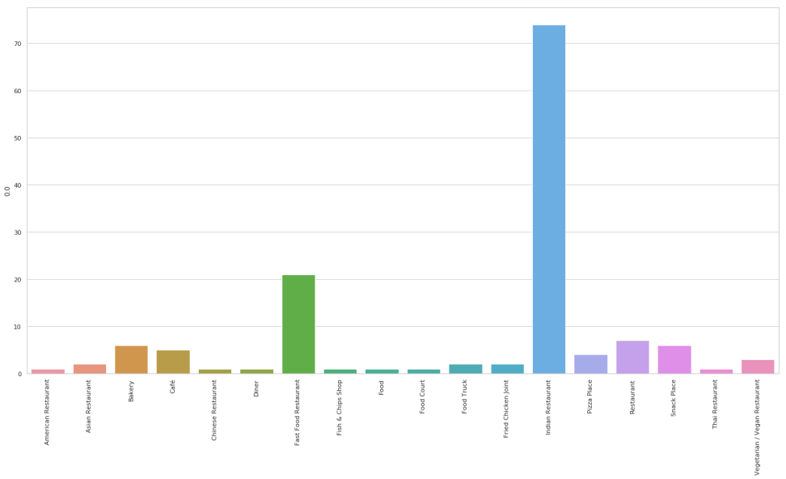
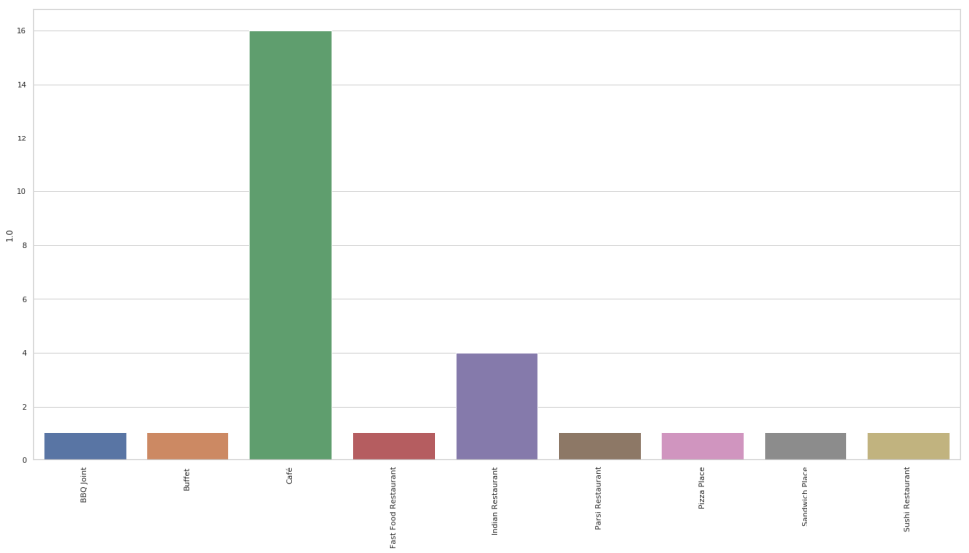
Cluster Analysis Visual Presentation…
Cluster 0
Cluster 1

Slide 13
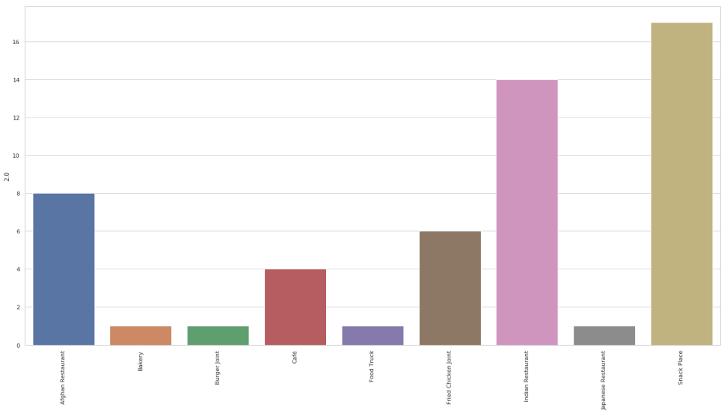
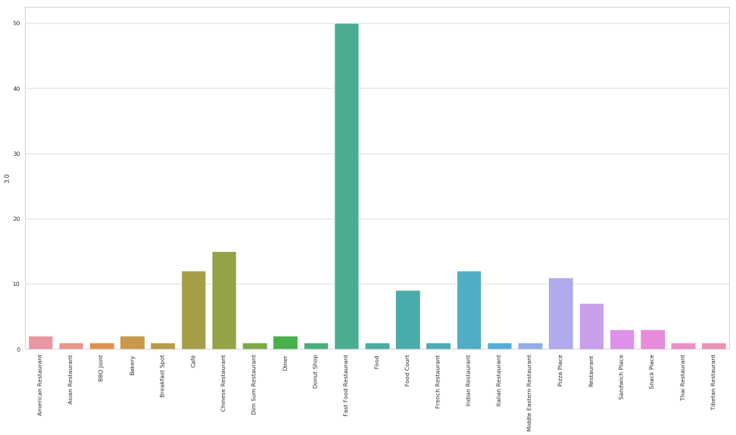
Cluster Analysis Visual Presentation…..
Cluster 2
Cluster 3

Slide 14
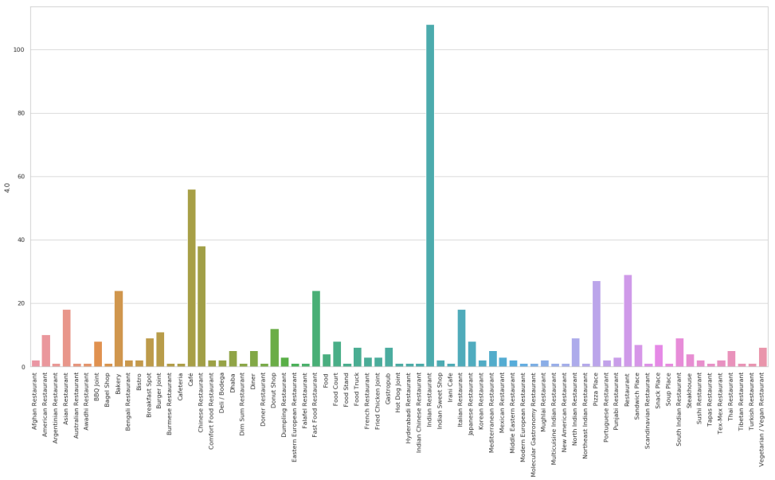
Cluster Analysis Visual Presentation
Cluster 4
Cluster 5
There were no data in this cluster

Slide 15
Analysing the Clusters
Filter Neighbourhoods with frequency>30% of Indian Restaurants (more supply)
Filter Neighborhoods with frequency > 70% for Non Indian Restaurants – overcrowded market
Select the 5 Most Popular Neighborhoods (New neighbourhood must be close to these)
Examine remaining neighborhoods which are close to popular neighborhoods and have less supply of Indian Restaurants frequency <30%
Finally zero on to the top neighborhoods for a new restaurant where demand supply gap exists and is closer to popular neighborhoods.

Slide 16
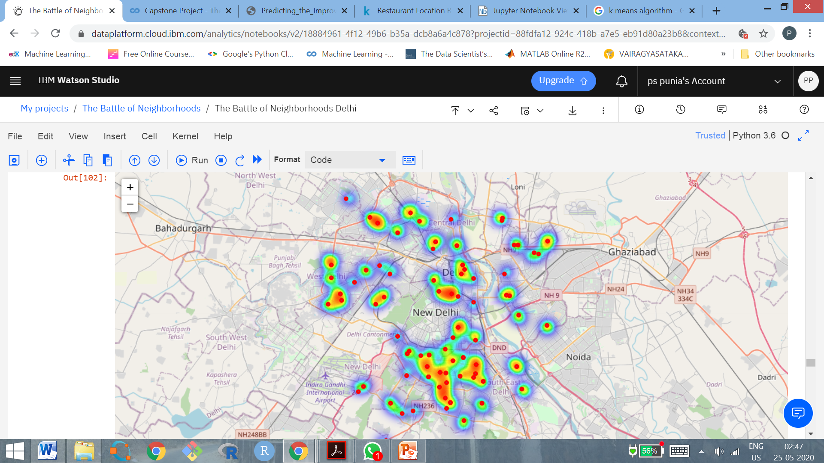
Map of Clusters All Type of Restaurants

Slide 17
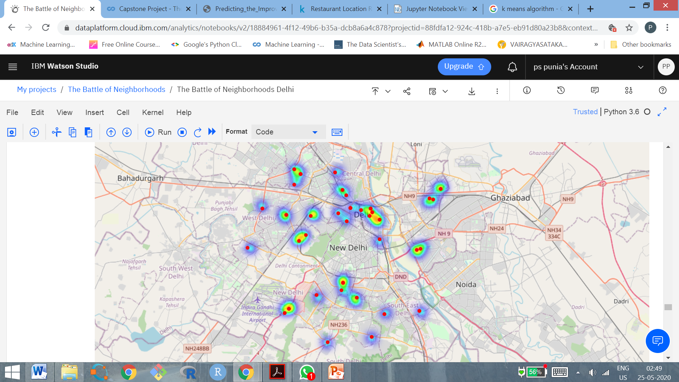
Clusters with Indian Restaurants

Slide 18
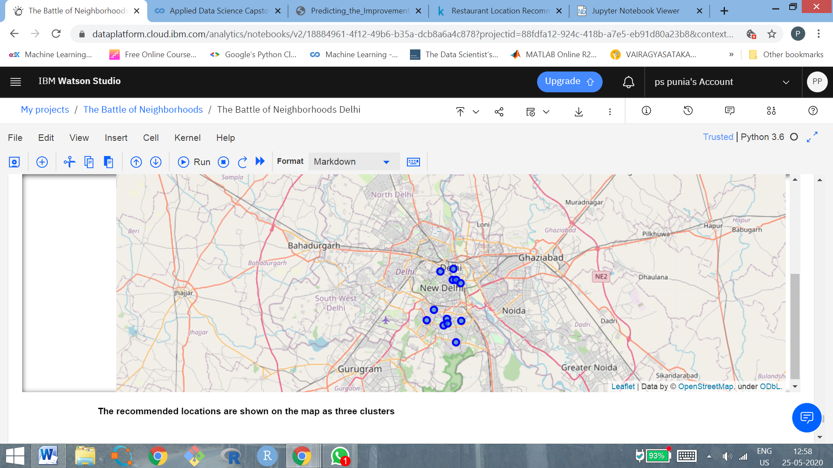
Final Recommended Sites on Map of Delhi

Slide 19
Conclusion
The K- means has generated the 2 main clusters with high density of Indian Restaurants
Analysed the clusters with high density and low density of Indian Restaurants
Selected 3 Most Popular Venues
Selected the 5 Neighborhoods from these venues as the final recommended neighborhoods
Finally 12 Neighborhoods are recommended for the location of New Indian Restaurant which are close to popular venues and has supply gap.

Slide 20
LIMITATIONS
Small size of Data Base 849 restaurants Delhi has more than 5000 restaurants but data is not available
Foursquare API – only selected 100 Venues – too small for city like Delhi
Foursquare APIs may not have the latest updates for Delhi neighborhoods.
With this Data only 5 clusters were selected but most of the data was only in 2 clusters.

